Slide 1
Service Transition

Slide 2
Agenda/Learning Objectives
Primary goals, objectives and business value of Service Transition
Generic concepts and definitions
Service Knowledge Management System (SKMS)
Configuration Item
Configuration Management System
Definitive Media Library
Service Change
Change Types (Normal, Standard & Emergency)
Release Unit
Seven R’s of Change Management

Slide 3
Agenda/Learning Objectives
Key Principles & Models
Service V Model
Processes – Objectives, Basic Concepts & Roles
Change Management
Service Asset Configuration Management (SACM)
Release and Deployment Management
Knowledge Management

Slide 4
Scope
The scope of Service Transition includes the management and co-ordination of the processes, systems and functions to package, build, test, and deploy a release into production and establish the service specified in the customer and stakeholder requirements

Slide 5
Primary Goals, Objects and Benefits
Service Transition

Slide 6
Goals and Objectives
To plan and manage the resources to successfully establish a new or changed service into production within the predicted cost, quality and time estimates
Ensure there is minimal unpredicted impact on the production services, operations and support organization
Ensure that service can be used in accordance with the requirements and constraints specified within the service requirements
Reduce known errors and minimize the risk from transitioning the new or changed services into production
Increase the customer, user and Service Management staff satisfaction with the Service Transition practices

Slide 7
Purposes
Plan and manage the capacity and resources required to package, build, test and deploy a release into production
Establish and maintain the integrity of all identified service assets and configurations
Provide good quality knowledge and information so that Change, Release and Deployment Management operate efficiently and effectively
Provide efficient repeatable build and installation mechanisms
Ensure that the service can be managed, operated and supported in accordance with the requirements and constraints specified within the service design

Slide 8
Business Value
Effective Service Transition can significantly improve a service provider’s ability to handle high volumes of change and releases across its customer base. It enables the service provider to:
Align new or changed service with the customer’s business requirements and business operations
Ensure that customers and users can use the new or changed service in a way that maximizes value to the business operations

Slide 9
Business Value
Specifically, Service Transition adds value to the business by improving:
The ability to adapt quickly to new requirements and market developments (‘competitive edge’)
The ability to cope with the transition management of mergers, de-mergers, acquisitions, transfer of services
The success rate of changes and releases for the business
Confidence in the degree of compliance with business and governance requirements during change

Slide 10
Business Value
…..by improving:
The variation of actual against estimated and approved resource plans/budgets
The productivity of business and Customer staff because of better planning and use of new and changed services
Timely cancellation or changes to maintenance contracts for both hardware and software when components are disposed or de-commissioned
The understanding of the level of risk during and after change e.g. service outage, disruption, re-work

Slide 11
Transition Planning and Support

Slide 12
Goals
Plan and coordinate the resources to ensure that the requirements of Service Strategy encoded in Service Design are effectively realized in Service Operation
Identify, manage and control the risk of failure and disruption across transition activities

Slide 13
Objectives
Plan and coordinate the resources to establish successfully a new or changed service into production within the predicted cost, quality and time estimates
Ensure that all parties adopt the common framework of standard re-usable processes and supporting systems in order to improve the effectiveness and efficiency of the integrated planning and coordination activities
Provide clear and comprehensive plans that enable the customer and business change projects to align their activities with the Service Transition plans.

Slide 14
Change Management
RFC
RFC
RFC
Service Asset and Configuration Management
BL
BL
BL
Service Transition Planning & Support
Management of organization & change
Evaluation of a Change of Service
Ev
Ev
Ev
Plan and prepare release
Build and test
Service testing and pilots
Plan and prepare for deploy
Transfer, deploy, release
Review and close
Release & Deployment
Management
Early life support
Service Validation and Testing
Knowledge Management

Slide 15
Change Management
Service Transition

Slide 16
Objectives
To ensure that changes are recorded and then evaluated, authorized, prioritized, planned, tested, implemented, documented and reviewed in a controlled manner

Slide 17
Purpose
Standardized methods and procedures are used for efficient and prompt handling of all Changes.
All changes to service assets and configuration items are recorded in the configuration management system
Overall business risk is known and optimised
Minimise the severity of any Change related impact and disruption

Slide 18
Purpose
Change is generally a GOOD THING
To improve a service
To add new functionality
To remove an error
To increase business benefit
But WE DON'T LIKE IT
It can give rise to incidents
It can be disruptive
It is frequently resisted
So Change needs to be MANAGED
Establish a change culture

Slide 19
A Service Change
The definition of a Service Change is 'The addition, modification or removal of an authorized, planned or supported service or service component and its associated documentation‘
The scope of Change Management covers changes to baseline service assets and configuration items across the whole Service Life Cycle.
Each organization should define the changes that lie outside the scope of their service change process – e.g.
Changes at an operational level such as repair to printers or other routine service components

Slide 20
Value to Business
Change prioritized according to business needs
Ability to cope with high volume of Changes
Reduced Incidents/outages due to poor changes
All changes evaluated for benefit/cost/risk etc
Audit trail to meet regulatory requirements
Contributing to meet governance, legal, contractual and regulatory requirements
Implementing changes that meet the customers' agreed service requirements while optimizing costs

Slide 21
3 Types of Change Model
Standard (Pre – Authorized) – A service change pre-authorised by change management with an accepted, established procedure (Model)‏
The crucial elements of a standard Change are that:
The tasks are well-known, documented and proven (there is a Model)‏
Authority is effectively given in advanced
Budgetary approval will typically be preordained or within the control of the Change requester
Usually low risk, and always well-understood risk
Standard Changes should be identified early on when building the Change managements process to promote efficiency.
Otherwise, a Change Management implementation can create unnecessarily high levels of administration and resistance to the change management process

Slide 22
3 Types of Change Model
Emergency – A model reserved for highly critical service changes needed to restore failed high availability, or intended to repair an error in an IT service that (could) negatively impact the business to a high degree.
Perceived as being risky and should be kept to a minimum
Ensures that speed does not sacrifice normal management controls
Effectively, the emergency change procedure will follow the normal change procedure except that:
Approval will be given by the ECAB rather than waiting for a CAB meeting
Testing may be reduced, or in extreme cases forgone completely, if considered a necessary risk to deliver the change immediately
Documentation, i.e. Updating the change record and Configuration data, may be deferred, typically until normal working hours

Slide 23
3 Types of Change Model
Normal – A non emergency service change that is not pre-approved (does not meet Standard criteria)
Progressed using the normal Change procedures

Slide 24
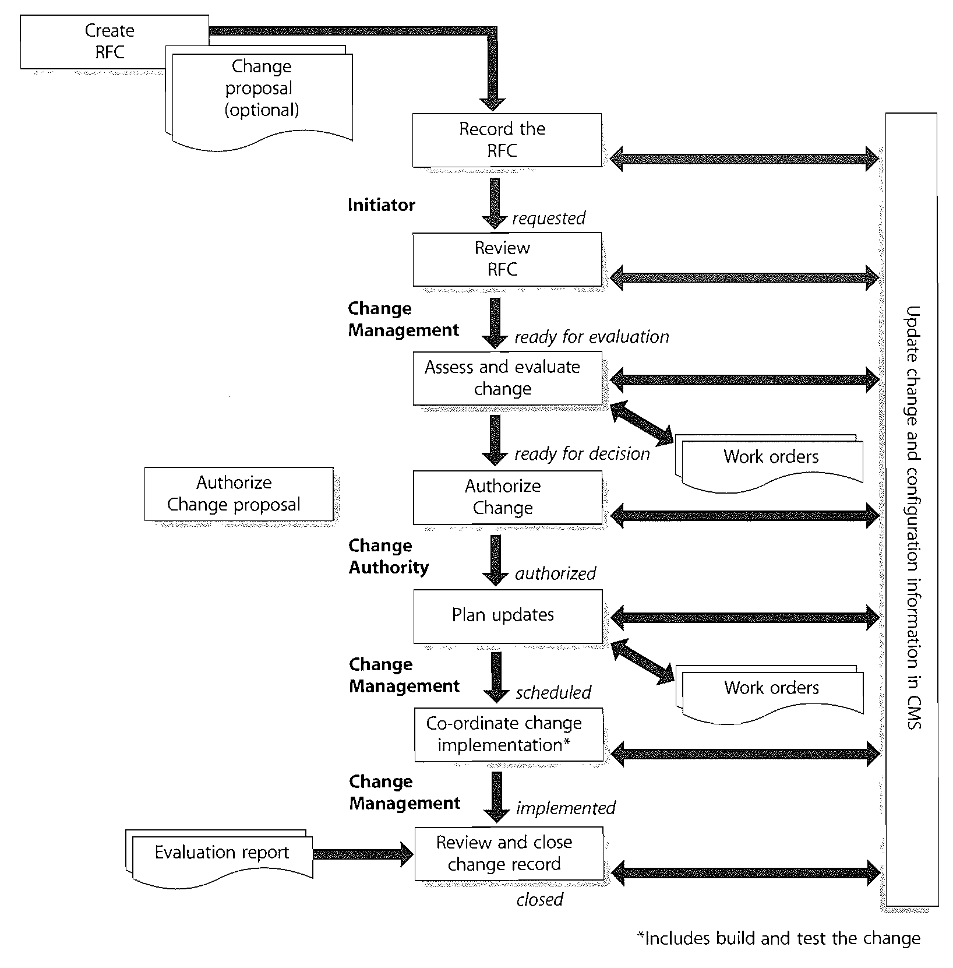
Create RFC
Change proposal
Change proposal
Record RFC
Review RFC
Assess & Evaluate
Work orders
Authorize change proposal
Authorize
Update change and configuration information in CMS
Plan Updates
Work orders
Co-ordinate Implementation*
Evaluation report
Review & Close

Slide 25
Change Process
Create & Recording RFC
Review and Filter RFC and change proposal
Assess and evaluate the change
Authorize the change
Plan update / change
Co-ordination Change implementation
Review and Close change

Slide 26
Create and Recording RFC
Anyone in the organization should be allowed to request a change
Change Proposals maybe required for major change with significant impact
All RFCs received should be logged and allocated a unique identification number
The level of detail in the RFC depends on the size and impact of the change.
Some information is recorded when the document is initiated and some information may be update as the change progresses
The change record holds the full history of the change, incorporation information from the RFC and subsequently recording agreed parameters such as priority and authorization, implementation, and review information
Initiator Raises RFC
Optional Change Proposal
CMS
(Change Record)
Record RFC
Rejected
Review RFC
Assess & Evaluate
Authorize

Slide 27
Review and Filter RFC
As Change are logged, Change Management should briefly consider each request and filter out any that seem to be:
Totally impractical
Repeats of earlier RFCs, accepted, rejected or still under consideration
Incomplete submissions, e.g. inadequate description, without necessary budgetary approval.
A right of appeal against rejection should exist, via normal management channels, and should be incorporation within the procedures
Initiator Raises RFC
Optional Change Proposal
CMS
(Change Record)
Record RFC
Rejected
Review RFC
Assess & Evaluate
Authorize

Slide 28
Asses and Evaluate (1)
All members of the change authority (CAB) should evaluate the change based on:
Impact
Urgency
Risk
Benefits
Costs
Initiator Raises RFC
Optional Change Proposal
CMS
(Change Record)
Record RFC
Rejected
Review RFC
Assess & Evaluate
Authorize

Slide 29
The Change Advisory Board (CAB)
The change Advisory Board (CAB) is a body that exists to support the authorization of the change and to assist Change Management in the assessment and prioritization of changes.
Will be composed according to the Change being considered (chaired by Change Manager)‏
May very considerably in make-up even across the range of a single meeting
Should involve suppliers when that should be useful
Should reflect both user and Customer views
For emergency Change use an ECAB

Slide 30
Emergency Change Advisory Board (ECAB)‏
Provides emergency assistance to the Change Manager
Selected to deal with specific urgent / Emergency change request
Communication likely to be by phone rather then a meeting
Same principle as CAB – evaluate, advise and approve (before any change)‏
Chaired by Change Manager

Slide 31
Asses and Evaluate (2)
The potential impact on the services of failed change and their impact on service assets and configurations need to be considered
Generic question (e.g. the ‘seven Rs’) provide a good starting point for assessment
The CAB then give an indication of whether they support approval of the Change
Initiator Raises RFC
Optional Change Proposal
CMS
(Change Record)
Record RFC
Rejected
Review RFC
Assess & Evaluate
Authorize

Slide 32
The 7R’s of Change
Questions to be asked by the CAB about all and any changes (to assist in Assessment and Evaluation)‏
Who RAISED the Change ?
What is the REASON for the Change?
What is the RETURN required from the change?
What resources are REQUIRED to deliver the change?
Who is RESPONSIBLE for the build, test and implementation of the change ?
What is the RELATIONSHIP between this change and other changes?
What are the RISK involved in the change?

Slide 33
Asses and Evaluate (3)
Prioritization is used to establish the order in which Change put forward should be considered
The priority of a change is derived from the agreed impact and urgency
Change Management coordination the production and distribution of a ‘Schedule of Change’ (SC) and ‘Projected Service Outage (PSO)
Initiator Raises RFC
Optional Change Proposal
CMS
(Change Record)
Record RFC
Rejected
Review RFC
Assess & Evaluate
Authorize

Slide 34
Authorize
Formal authorization is obtained for each change authority that may be a role, person or a group of people.
A degree of delegated authority may well exist within authorization level, e.g. delegation authority to a Change Manager according to pre-set parameters relating to :
Anticipation business risk
Financial implications
Scope of the change
The level of which changes is authorized should rest where accountability for accepting risk and remediation exist
Initiator Raises RFC
Optional Change Proposal
CMS
(Change Record)
Record RFC
Rejected
Review RFC
Assess & Evaluate
Authorize

Slide 35
Delegated Authority
Change Authority
Examples (of Configuration Level impacted)
Level 1
Executive Business Board
High cost/risk Change – Requires decision from Executives
Level 2
IT Management Board
Change impacts multiple Services or organizational divisions
Level 3
CAB or ECAB
Change which impacts only local or Service Group
Level 4
Local Authorization
Standard Change

Slide 36
Plan Updates
Ensure relevant IT and Business documentation is update / plan to be updated as a consequence of planned change, e.g.
Capacity Plan
IT Service Continuity Plan
Etc.
Authorize
CMS
(Change Record)
Plan Updates
Co-ordinate Implementation
Review & Close
Evaluation Report

Slide 37
Co-ordinate Implementation
Authorized RFCs should be passed to the relevant technical group for building of the change.
Change Management has responsibility for ensuring that changes are implemented as scheduled (largely a coordination role as the actual implementation will be the responsibility of others)‏
Change Management has an oversight role to ensure that all Change that can be, are thoroughly tested (inc remediation plan prepared and tested)
Authorize
CMS
(Change Record)
Plan Updates
Co-ordinate Implementation
Review & Close
Evaluation Report

Slide 38
Review and Close
A Change Review (Post Implementation Review) should be carried out to confirm that e.g.
That Change has met its objectives
That the initiator and stakeholder are happy with the results
The resources used to implement the Change were as planned
The release and deployment plan worked correctly
That there have been no unexpected side effects.
The remediation plan functioned correctly, if needed
Any lessons learnt
This process will involve CAB members; since change reviews ate a standard CAB agenda item
Authorize
CMS
(Change Record)
Plan Updates
Co-ordinate Implementation
Review & Close
Evaluation Report

Slide 39
KPIs & Metrics (examples)
The number of change implemented to services which met the customers agreed requirements e.g. quality/cost/time (expressed as a percentage of all changes)‏
Reduction in the number of disruptions to services, caused by inaccurate specification, poor or incomplete impact assessment
Reduction in the number/ratio of unauthorized changes
Reduction in the backlog of change requests
Reduction in the number and percent of change that do not follow formal change management procedures
Reduction in the number of failed changes

Slide 40
Change Manager's Role
RFCs – Receive, log & allocate priority (Reject incomplete & impractical)
RFCs - CAB meeting administration
CAB – Attendees
Convene urgent CAB or ECAB
Chair CAB and ECAB meetings
After CAB or ECAB: authorize or reject
Issue Change Schedule
Coordinate building, testing & implementation
Update the Change log
Review implemented Changes
Review outstanding RFCs
Analyze Change records (trends / problems)‏
Close RFCs
Management reports

Slide 41
Change Management Roles
Change Authority
Formal authorization is obtained for each change from a change authority that may be a role, person or group of people
CAB (ECAB)‏
Composed according to change, include :
Problem Manager
Service Level Manager
Customer Relations Staff
Etc
Chaired by Change Manager

Slide 42
Service Asset Configuration Management (SACM)
Service Transition

Slide 43
Goal of SACM
To provide a logical model of the IT infrastructure correlating IT services and different IT components (physical, logical, etc) needed to deliver these services

Slide 44
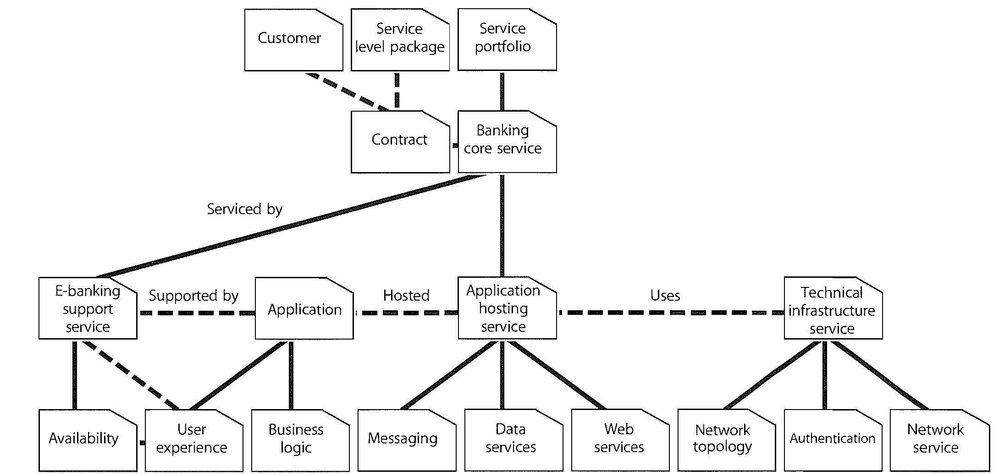
Logical Model

Slide 45
Objectives
To define and control the components of services and the IT infrastructure and to maintain accurate configuration records
This enables an organisation to comply with corporate governance requirements, control asset base, optimise its costs, manage change and releases effectively, and resolve incidents and problems faster

Slide 46
Scope – Asset Management
Provides a complete inventory of assets and who is responsible for their control, including:
Full Life Cycle Management of IT and service assets, from point of acquisition or acquisition through disposal (across the whole Service Life Cycle)‏
Responsible for tracking and reporting the value and ownership of financial assets throughout their lifecycle (incl. Maintenance of the asset inventory)

Slide 47
Scope – Asset Management
An asset is defined as any resource or capability
Assets of a service provider include anything that could contribute to the delivery of a service
Assets can be one of the following types :
Management
Organization
Process
Knowledge
People
Information
Application
Infrastructure
Financial capital

Slide 48
Scope – Configuration Management
Responsible for maintaining information about the Configuration Items required to deliver an IT Service
It ensure that selected components of a complete service or system or product (the configuration) are identified, baseline and maintained and that changes to them are controlled
It provides a logical model of the service, assets and the infrastructure by recording the information about components (Configuration Items) and the relationships between these items
Type of CIs include: IT Services, Hardware, Software, People, Buildings, Formal Documentation

Slide 49
Basic Concepts - CIs
A Configuration Item (CI) is an asset, service component or other item that is, or will be, under the control of Configuration Management
Essentially a CI is any component that needs to be managed in order to deliver an IT Service
Information about each CI is recorded in a Configuration Record within the Configuration Management System and is maintained throughout its lifecycle by Configuration Management (although CIs are under the control, of Change Management)‏

Slide 50
Basic Concepts – CI Categories
Service Life Cycle CIs
Service CIs
Organisation CIs
Internal CIs
External CIs

Slide 51
Service Life Cycle CIs
CIs that provide a picture of the service provider's services, how these services will be delivered, what benefits are expected, at what cost, and when they will be released – e.g
The Business Case
Service Management Plans
Service Life Cycle Plans
Service Design Package
Release and Change Plans
Test Plans

Slide 52
Service CIs
Service capability assets
Management
Service resource assets
Financial capital
Organization
Processes
Knowledge
People
Systems
Applications
Information
Data, infrastructure and facilities
Financial capital
People

Slide 53
Organisation CIs, Internal/External CIs
Organization CIs
Organization's business strategy
IT Policies
Regulatory & statutory requirements
Internal CIs
Software, hardware, facilities for individual projects
External CIs
External customer requirements and agreements
Release from suppliers or sub-contractors
External service

Slide 54
CI Attributes
Attribute –The descriptive information about a CI
Clearly this will differ from CI, though some identifying attributes will be common
Examples of attributes might be:
Unique Id (required), Type (required), Make, Model, Status, Version No., Serial No., Supplier, Cost, Purchase Date, Location, Owner, etc

Slide 55
CI Relationships
Describes the link between two CIs
Relationships are the main difference between configuration management and asset management
Examples
PC is connected to LAN
Accounts clerk uses SAP
Fire Instruction are part of Staff Manual

Slide 56
The Logical Model
Configuration management delivers a logical model of the services, assets and the infrastructure by recording the relationships between configuration items
There is a single model – giving a common view
Therefore everybody has common and same level of understanding of the environment because of the single model

Slide 57
The Logical Model
Services
E-Banking
E-Sales
User experience
Application
Application
User experience
Availability
SLA
Business Logic
Business Logic
Availability
SLA
Application Infrastructure
Application Infrastructure
Messaging
Data
Services
Web
Services
Web
Services
Data
Services
Messaging
Data Center Network
Authentication
Network Topology
Name Service
Notes:
This enables other processes to access valuable information e.g
to assess the impact and cause of incidents and problems
to assess the impact of proposed changes
to plan and design new or changed services
to plan technology refresh and software upgrades
to plan release and deployment packages and migrate service assets to different locations and service centre

Slide 58
Configuration Management System
The Configuration Management System (CMS) holds all the information relating to service asset and configuration management
The CMS holds all the information for CIs within the designated scope
The CMS maintains the relationships between all service components and any related Incidents, Problems, Known Errors, Change and Releases

Slide 59
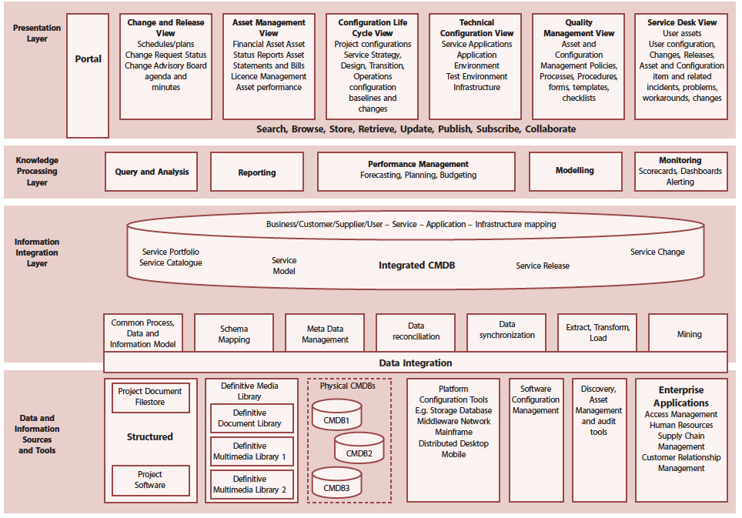

Slide 60
Configuration Management System
At the data level, the CMS may take data from several physical Configuration Management Databases (CMDBs), which together constitute a federated CMDB
Other data sources will also plug into the CMS such as the Definitive Media Libraries

Slide 61
Definitive Media Library (DML)
The DML is a foundation for release and deployment management
It is the secure library in which the definitive authorized versions of all media CIs are stored and protected
It stores master copies of versions that have passed quality assurance checks
In reality it may consist of one or more software libraries or file storage areas, separate from development, test or live file-store areas
It contains the master copies of all controlled software in an organization

Slide 62
Definitive Media Library
The DML should include definitive copies of purchased software (along with license documents or information), and software developed on site
Master copies of controlled documentation for a system are also stored in the DML in electronic form
The DML will also include a physical store to hold master copies e.g. a fireproof safe
Only authorized media should be accepted into the DML, strictly controlled by SACM

Slide 63
Definitive Spares Secure Storage Area(s)
An area should be set aside for the secure storage of hardware spares
These are spare components and assemblies that are maintained at the same level as the comparative systems within the live environment
Can be used in a controlled manner when needed for training, testing or incident recovery
Details of these components, their locations and their respective builds and contents should be comprehensively recorded in the CMS

Slide 64
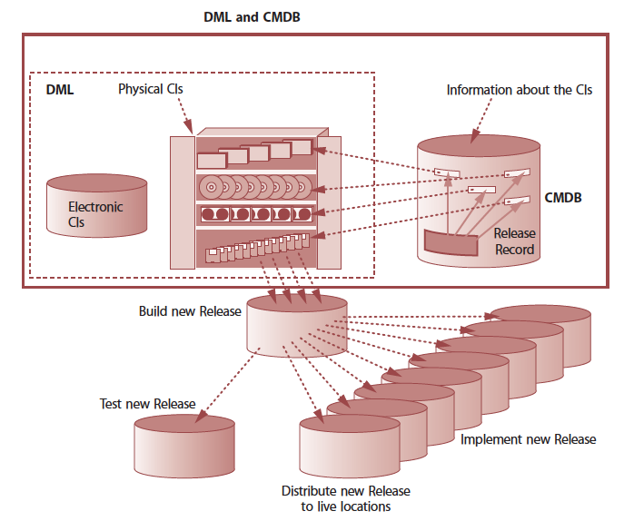

Slide 65
Baseline
A configuration Baseline is the configuration of a service, product or infrastructure that has been formally reviewed and agreed e.g. a Desktop Build
Any subsequent modifications can only be made through formal change procedures

Slide 66
Snapshot
A snapshot is the current state of configuration items or environment
This snapshot is recorded in the CMS and remains as a fixed historical record at a point in time
A snapshot is not necessarily formally reviewed agreed upon – it is just a documentation of a state
The snapshot enables e.g.:
Problem management to analyse evidence in respect of the situation pertaining at the time incidents actually occured

Slide 67
SACM Process
Management & Planning
Configuration Identification
Configuration Control
Status Reporting
Verification & Audit

Slide 68
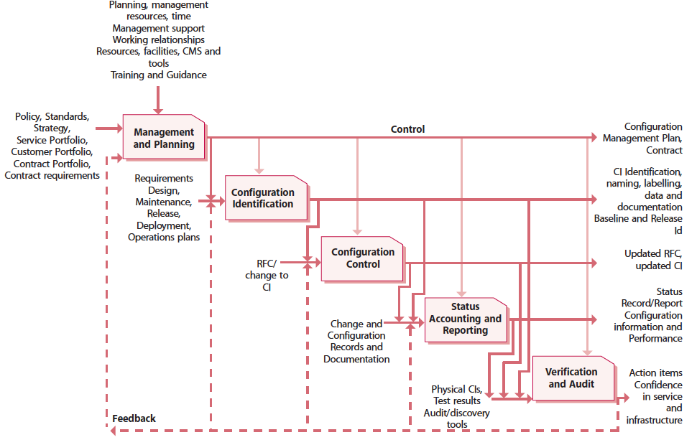

Slide 69
Management & Planning
During the initial planning phase the following should be defined and documented in a Configuration Management Plan :
Purpose, scope and objectives of SACM
Policies and standards
The organisational context (relationship to change, release and deployment)
Roles and responsibilities
CMS and Tools

Slide 70
Configuration Identification
Define and document criteria for selecting CIs, then select the CIs and assign unique identifiers
Specify the relevant attributes of each configuration item
Specify when each configuration item is placed under configuration management
Identify the owner responsible for each configuration item

Slide 71
Configuration Control
Configuration control ensure that there are adequate control mechanism over CIs while maintaining a record of changes to status, approvals, location and custodianship or ownership
Without control the configuration data would not match the real world
No CI should be added, modified, replaced or removed without appropriate controlling documentation or procedure being followed

Slide 72
Status Reporting
Each asset or CI will have one or more discrete states through which it can progress. There will typically be a range of states relevant to the individual asset or CIs
Configuration status reporting is concerned with ensuring that all configuration data and documentation is recorded as each asset or CI progresses through its life cycle
It provides the status of the configuration is a service and its environment as the configuration evolves through the Service Life Cycle

Slide 73
Verification and Audit
Verification & Audit – includes a series of reviews or audits to ensure:
There is conformity between the documented baselines and the actual business environment to which they refer
To verify the physical existence of CIs in the physical infrastructure, the DML, and the spares stores match the records in the Configuration Management System
Checking that release and configuration documentation is present before making a release

Slide 74
Roles
Service Asset Manager
Configuration Analyst
Design & maintains the Asset Management Systems and implements Service Asset Management Policy & Standards
Configuration Manager
Design & maintains the Configuration Management System, and agrees the scope of the process, identify naming conventions, etc
Proposes scope of the Asset and Configuration Management processes, function, the items that are to be controlled, and the information that is to be recorded

Slide 75
Roles
Configuration Administrator/ Librarian
CMS/Tools Administrator
Manage SACM tools
Performance & capacity: SACM systems
Technical administration & support
Integrity & interoperability
The custodian and guardian of all master copies of software, Assets and documentation CIs registered with Asset and Configuration Management.
Configuration Control Board
To ensure that the overarching intention and policies of Configuration Management are employed throughout the Service Management Lifecycle

Slide 76
Release and Deployment Management
Service Transition

Slide 77
Goals
The goal of Release and Deployment Management is to deploy Release into production and enable effective use of the service in order to deliver value the customer

Slide 78
Objectives
To ensure that:
There are clear and comprehensive release and deployment plans
A release package can be built, installed tested and deployed successfully and on schedule
A new of change system, component etc, is capable of delivering the agreed service requirements i.e. utilities, warranties and service levels.
There is knowledge transfer to enable the customers and user to optimize their use of the service to support their business activities
Skill and knowledge are transferred to operations and support staff to enable them to effectively and efficiently deliver, support and maintain service according to required warranties and service levels.
There is minimal unpredicted impact on the production services, operation and support organization

Slide 79
Value to the Business
Delivering change, faster and at optimum cost and minimized risks
Assuring that customers and users can use the new or change service in a way that supports the business goals
Improving consistency in implementation approach across the business change, service teams, suppliers and customers
Contributing to meeting auditable requirement for traceability through service transition

Slide 80
Release Policy
Release Policy – Overall Policy to manage all Releases, and includes:
The unique identification, numbering and naming conventions for different types of release
The approach for accepting and grouping changes into a release
The roles and responsibilities at each stage of a release
The expected frequency for each type of release

Slide 81
Release Unit
Release unit, describes the portion of a service or IT infrastructure that is normally released together according to the organization’s release policy
The unit may vary, depending on the type(s) or item(s) of service asset or service component such as software and hardware
The general aim is to decide the most appropriate Release-unit level for each service asset or component

Slide 82
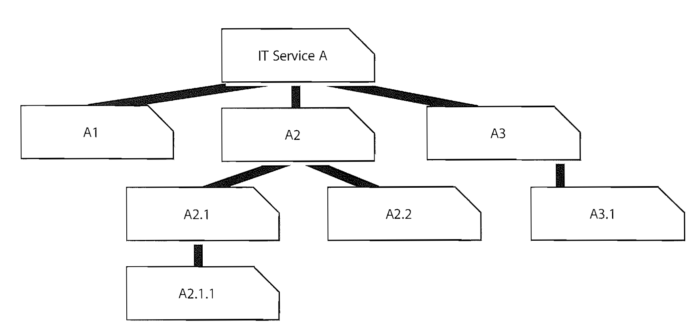
Release Unit

Slide 83
Options for Deploying a Release Unit
Big Bang vs. Phased
Push vs. Pull
Automated vs. Manual
Big-bang option – the new or changed service is deployed to all user areas in one operation
Phased approach – the service is deployed to part of the user base initially, and then this operation is repeated for subsequent parts of the user base via a scheduled roll out plan
A Push approach is used where the service component is deployed from the centre and pushed out the target locations
A Pull approach is used for software releases where the software is made available in a central location but user are free to pull the software down to their own location at a time of their choosing or when a user workstation restarts
Automation will help to ensure repeatability and consistency
If a manual mechanism is used it is important to monitor and measure the impact of many repeated manual activities as they are likely to be inefficient and error prone

Slide 84
Early Life Support
Early Life Support – Overall Policy to manage all Releases, and includes:
Provides smooth transition of the new or changed service
Provides appropriate resources to resolve operational and support issues quickly
During ELS the deployment team implements and resolves problems
ELS gradually backs-out and hands over today to day support as service stabilizes

Slide 85
Roles – Release and Deployment Manager
Responsible for planning, design, build, configuration & testing of software & hardware to create a Release package for the delivery of, or changes to, the designated Service
Manage end-to-end releases process
Update SKMS and SACM/CMDB
Co-ordinate build, test & release teams
Progress reports
Policy and planning

Slide 86
Roles – Release and Deployment Manager
.. Policy and Planning
Package design, build & configuration
Release acceptance
Rollout planning
Release testing
Sign-off
Communication and training
Pre-release audit
Hardware installation
Software storage & traceability/auditability
Release, distribution & installation

Slide 87
Roles – Release Packaging & Build Mngt
Manage flow of work (establish requirements, design, build, test, deploy, operate and optimize) to deliver applications and infrastructure that meet the Service Design requirements
Establish final release configuration
Build final release delivery
Test final delivery
Establish and report outstanding known errors and workarounds
Provide inputs to final implementation

Slide 88
Roles – Deployment
Responsible for the final physical delivery of the service implementation
Co-ordinates release documentation and communicates, including training and customer service management and technical release notes
Plans the deployment in conjunction with Change and SKMS and SACM
Provides technical and application guidance and support throughout the release process, including known errors and workarounds
Provides feedback on the effectiveness of the release
Records metrics for deployment to ensure within agreed SLAs

Slide 89
Service Validation and Testing

Slide 90
Background
If services are not tested sufficiently then their introduction into the operational environment will bring a rise in:
Incidents, since failures in service elements and mismatches between what was wanted and what was delivered impact on business support
Service desk calls for clarification, since services that are not functioning as intended are inherently less intuitive causing a higher support requirement
Problems and errors that are harder to diagnose in the live environment
Costs, since errors are more expensive to fix in production than if found in testing
Services that are not used effectively by the users to deliver the desired value.

Slide 91
Purpose
Plan and implement a structured validation and test process that provides objective evidence that the new or changed service will support the customer’s business and stakeholder requirements, including the agreed service levels
Quality assure a release, its constituent service components, the resultant service and service capability delivered by a release
Identify, assess and address issues, errors and risks throughout Service Transition

Slide 92
Objectives
Provide confidence that a release will create a new or changed service or service offerings that deliver the expected outcomes and value for the customers within the projected costs, capacity and constraints
Validate that a service is ‘fit for purpose’ – it will deliver the required performance with desired constraints removed
Assure a service is ‘fit for use’ – it meets certain specifications under the specified terms and conditions of use
Confirm that the customer and stakeholder requirements for the new or changed service are correctly defined and remedy any errors or variances early in the service lifecycle as this is considerably cheaper than fixing errors in production.

Slide 93
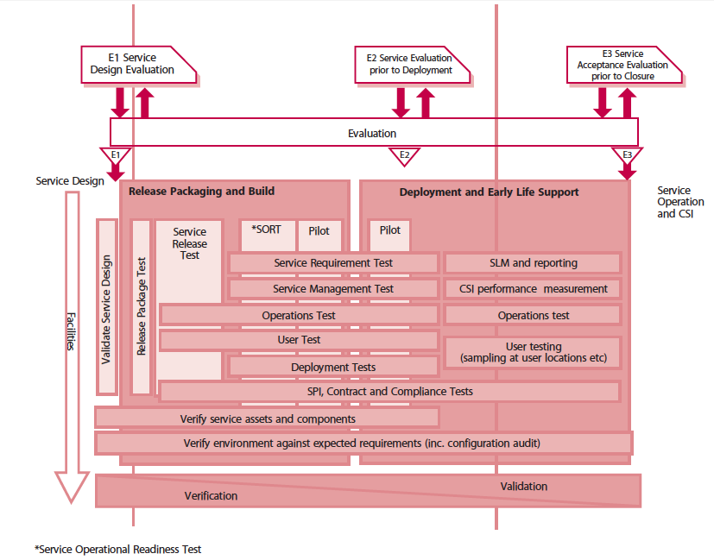

Slide 94
The Service V Model
The service V model provides an example of a model that can be used to represent the different configuration levels to be built and tested to deliver a service capability.
The left-hand side represents the specification of the service requirements.
The right-hand side focuses on the validation activities that are performed against the specification defined on the left-hand side.
At each stage on the left hand side, there is direct involvement by the equivalent party on the right hand side.
It shows that service validation and acceptance test planning should start with that definition of the service requirements.

Slide 95
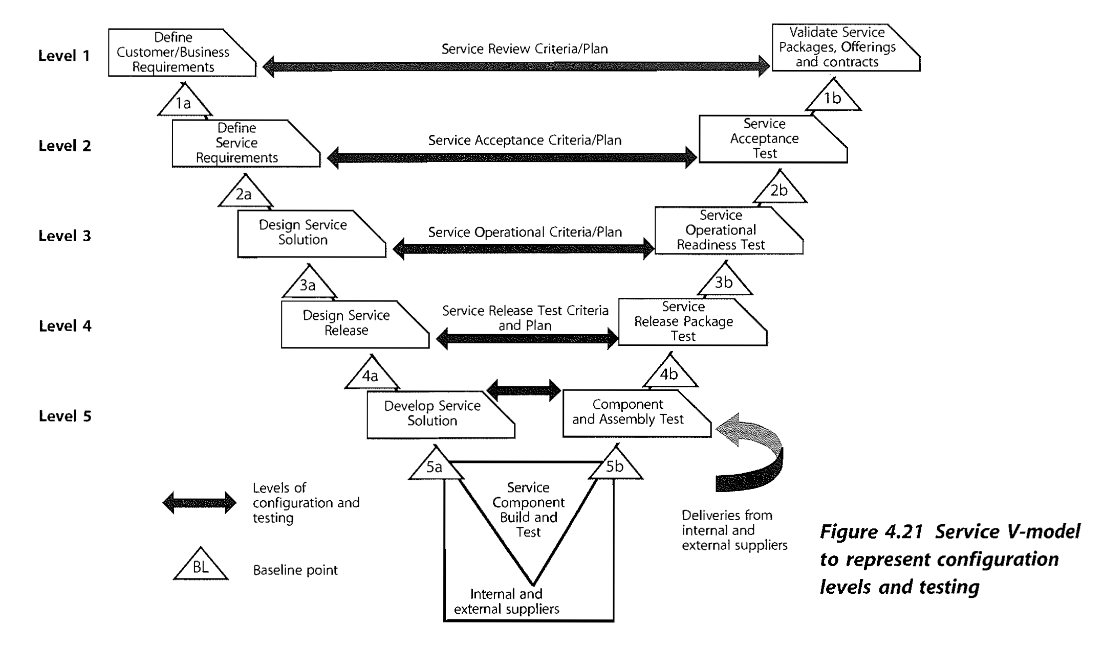
The Service V Model

Slide 96
Knowledge Management
Service Transition

Slide 97
Goal
The goal of Knowledge Management is to enable organizations to improve the quality of management decision making by ensuring that reliable and secure information and data is available throughout the service lifecycle
Key to this is the Service Knowledge Management System (SKMS)

Slide 98
The SKMS
What is the Service Knowledge Management System (SKMS) ?
A set of tools and databases used to manage knowledge and information
The SKMS includes the Configuration Management System (CMS) as well as other tools and databases
The SKMS looks after all the information needed by a provider to manage the full lifecycle of IT services
The SKMS is lifecycle-wide, but is covered mainly in Service Transition because of its dependence on Configuration Management

Slide 99
The SKMS
Within IT Service Managements, knowledge management will be focused within the service knowledge management systems (SKMS)‏
Underpinning this knowledge will be a considerable quantity of data, which will be held in a central logical repository or configuration management system (CMS) and databases (CMDB)‏
However, the SKMS is a broader concept that covers a much wider base of knowledge, for example:
The experience of staff
Records of peripheral matters, e.g. User numbers and behaviour, organization's performance figures
Supplier and partners requirements, abilities and expectations
Typical and anticipated user skill levels.

Slide 100
The SKMS
Data is gathered within the CMDB, feeds through the CMS into the SKMS and supports the informed decision making process
Service Knowledge
Management System
(SKMS)
Data
Information
Knowledge
Wisdom
Service Asset and Configuration Management
(SACM)
Configuration Management System (CMS)
Decisions
Configuration
Management
Databases
(CMDBs)

Slide 101
Learning Objectives – Achieved?
Primary goals, objectives and business value of Service Transition
Generic concepts and definitions
Service Knowledge Management System (SKMS)
Configuration Item
Configuration Management System
Definitive Media Library
Service Change
Change Types (Normal, Standard & Emergency)
Release Unit
Seven R’s of Change Management

Slide 102
Learning Objectives – Achieved?
Key Principles & Models
Service V Model
Processes – Objectives, Basic Concepts & Roles
Change Management
Service Asset Configuration Management (SACM)
Release and Deployment Management

Slide 103
Testing Your Knowledge
Service Transition

Slide 104
Question #1
What of the following is not a Category of CI?
Service Lifecyle CIs
Physical CIs
Service CIs
Organization CIs

Slide 105
Question #1
What of the following is not a Category of CI?
Service Lifecyle CIs
Physical CIs
Service CIs
Organization CIs

Slide 106
Question #2
Which of the following about Emergency Changes is incorrect?
Emergency Changes should be tested as thoroughly as possible
The ECAB will be chaired by the Change Manager
The number of Emergency Changes should be minimized
An Emergency Change is only permitted if there are no risks associated with the change

Slide 107
Question #2
Which of the following about Emergency Changes is incorrect?
Emergency Changes should be tested as thoroughly as possible
The ECAB will be chaired by the Change Manager
The number of Emergency Changes should be minimized
An Emergency Change is only permitted if there are no risks associated with the change

Slide 108
Question #4
Which of the following statements regarding a Snapshot is false?
A snapshot is the current state of configuration item or an environment
The snapshot is recorded in the CMS and remains as fixed historical record at a point in time
A snapshot is always a collection of Cis captured from a historical perspective
A snapshot is not necessarily formally reviewed and agreed upon – it’s just a documentation of a state

Slide 109
Question #4
Which of the following statements regarding a Snapshot is false?
A snapshot is the current state of configuration item or an environment
The snapshot is recorded in the CMS and remains as fixed historical record at a point in time
A snapshot is always a collection of Cis captured from a historical perspective
A snapshot is not necessarily formally reviewed and agreed upon – it’s just a documentation of a state

Slide 110
Question #5
Which changes should be subject to a Post Implementation Review?
All changes
Emergency changes only
All changes except standard changes
All CAB approved changes

Slide 111
Question #5
Which changes should be subject to a Post Implementation Review?
All changes
Emergency changes only
All changes except standard changes
All CAB approved changes

Slide 112
Question #6
Which is the correct sequence of activities in the SACM process?
Management & Planning – Configuration Identification – Status Reporting – Configuration Control – Verification & Audit
Asset Management– Configuration Control – Status Reporting – Verification & Audit
Status Reporting – Configuration Identification – Management and Planning – Configuration Control – Verification & Audit
Management & Planning – Configuration Identification – Configuration Control – Status Reporting – Verification & Audit

Slide 113
Question #6
Which is the correct sequence of activities in the SACM process?
Management & Planning – Configuration Identification – Status Reporting – Configuration Control – Verification & Audit
Asset Management– Configuration Control – Status Reporting – Verification & Audit
Status Reporting – Configuration Identification – Management and Planning – Configuration Control – Verification & Audit
Management & Planning – Configuration Identification – Configuration Control – Status Reporting – Verification & Audit

Slide 114
Question #7
Which is the second R in the 7Rs of Change?
Resources
Reason
Review
Raised

Slide 115
Question #7
Which is the second R in the 7Rs of Change?
Resources
Reason
Review
Raised

Slide 116
Question #8
The Service V Model is used to:
Record and report on the status of a Configuration item through its lifecycle
Represent the different Configuration levels to be built and tested to deliver a service capability
Act as a checkpoint before deploying a release into the live environment and providing a regression point if needed
Measure the total cost of delivering an IT Service and the total value of that IT Service to Business

Slide 117
Question #8
The Service V Model is used to:
Record and report on the status of a Configuration item through its lifecycle
Represent the different Configuration levels to be built and tested to deliver a service capability
Act as a checkpoint before deploying a release into the live environment and providing a regression point if needed
Measure the total cost of delivering an IT Service and the total value of that IT Service to Business

Slide 118
Question #9
The following are all recognized roles in Service Management. Which of the following are likely member of the Change Advisory Board?
The Product Manager
The Capacity Manager
The Availability Manager
The Information Security Manager
1 and 2 only
2 and 3 only
All of them
None of them

Slide 119
Question #9
The following are all recognized roles in Service Management. Which of the following are likely member of the Change Advisory Board?
The Product Manager
The Capacity Manager
The Availability Manager
The Information Security Manager
1 and 2 only
2 and 3 only
All of them
None of them

